Slide 1

Lunar Impact Flashes
Why observe them?
Impacting meteoroid size and mass
Temperature of the impact
Amount of displaced material caused by the impact
Generate statistics of the frequency and size of impacts
https://twitter.com/esaoperations/status/1638479928017534976

Slide 2
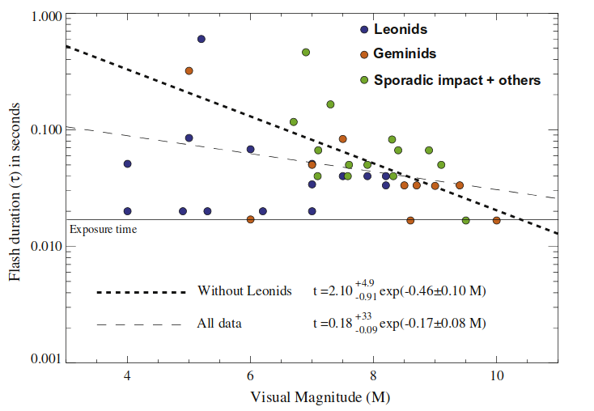
Lunar Impact Flashes
Typically lunar impact flashes are observed with cameras that have a frame rate of 30FPS.
Imapcts typically only last 1-3 frames
Impact observations dimmer than apparent magnitude 9 are difficult due to the short duration of the flash, the background illumination caused by earth shine, and the integration period used with 30FPS observations
Verifying flashes as meteoroid impact difficult due to small number of frames
Power and duration of impact flashes on the Moon: Implication for the cause of radiation - S. Bouley et al.

Slide 3
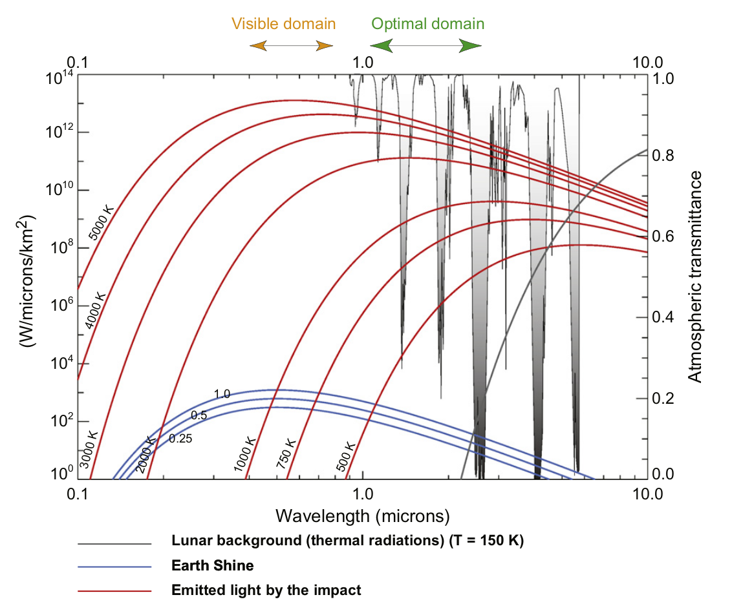
Bouley+ 2012

Slide 4
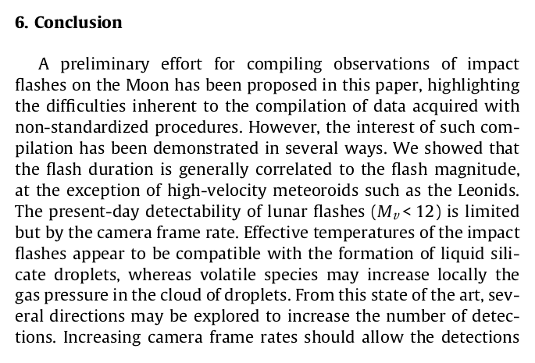
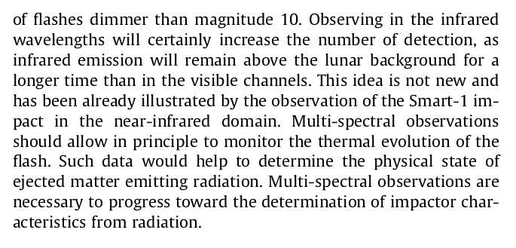
Bouley+ 2012

Slide 5
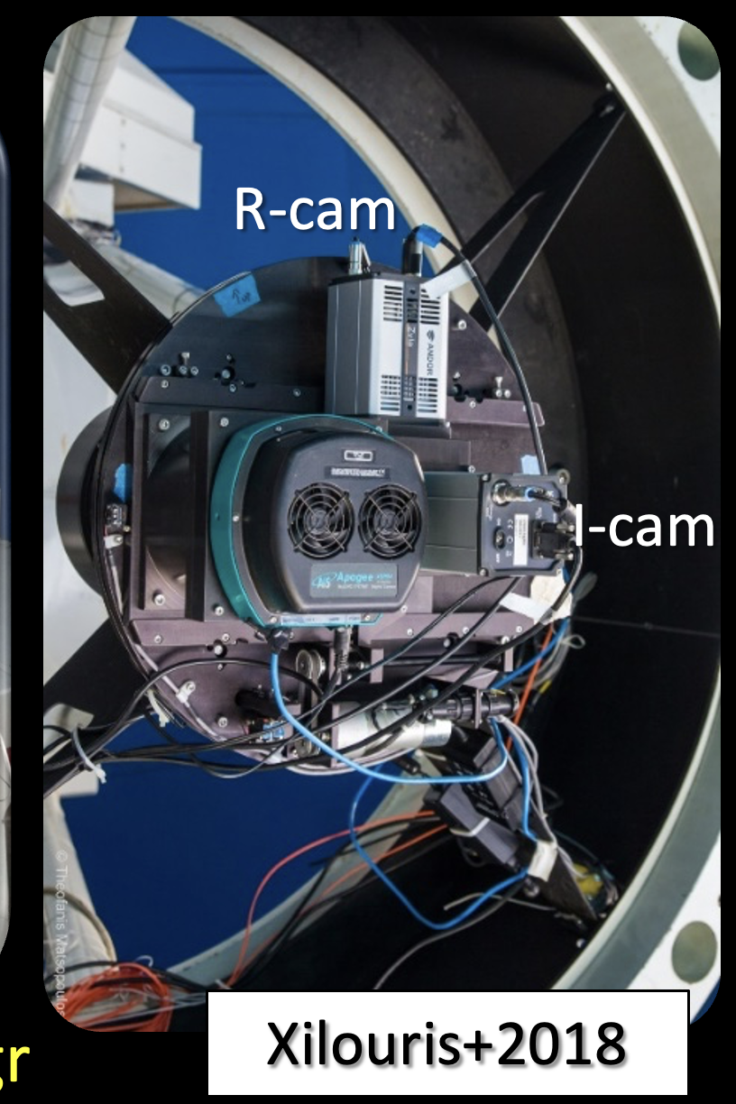
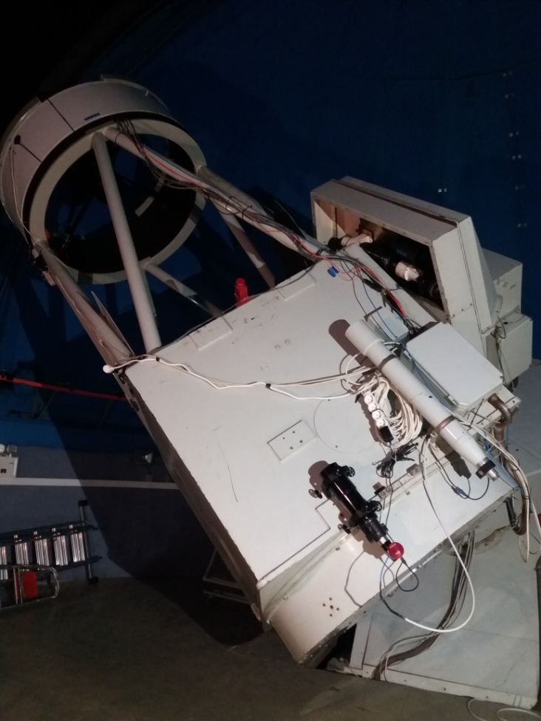
NELIOTA
1.2 m Kryoneri telescope (f/2.8, prime focus)
Twin sCMOS camera system with a dichroic beam splitter
R and I filters

Slide 6

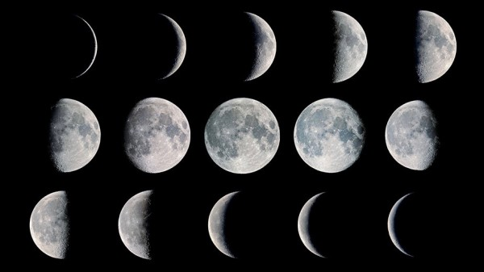
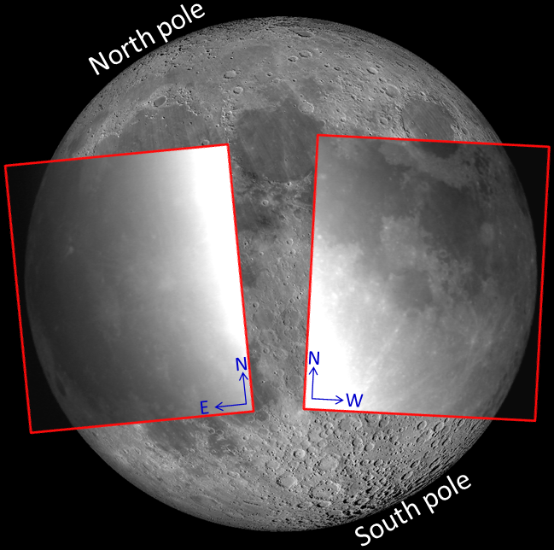
Observing strategy
Non-sunlit (night) side
Phases between 0.1-0.45 →~5-8 nights/month → 20´- 5 hr
Simultaneous recording in R and I bands with 30 fps (23 ms exposures)
Moon elevation 10-18 deg
FoV: 16´×14.4´
<Observable area>: 3×10⁶ km²

Slide 7
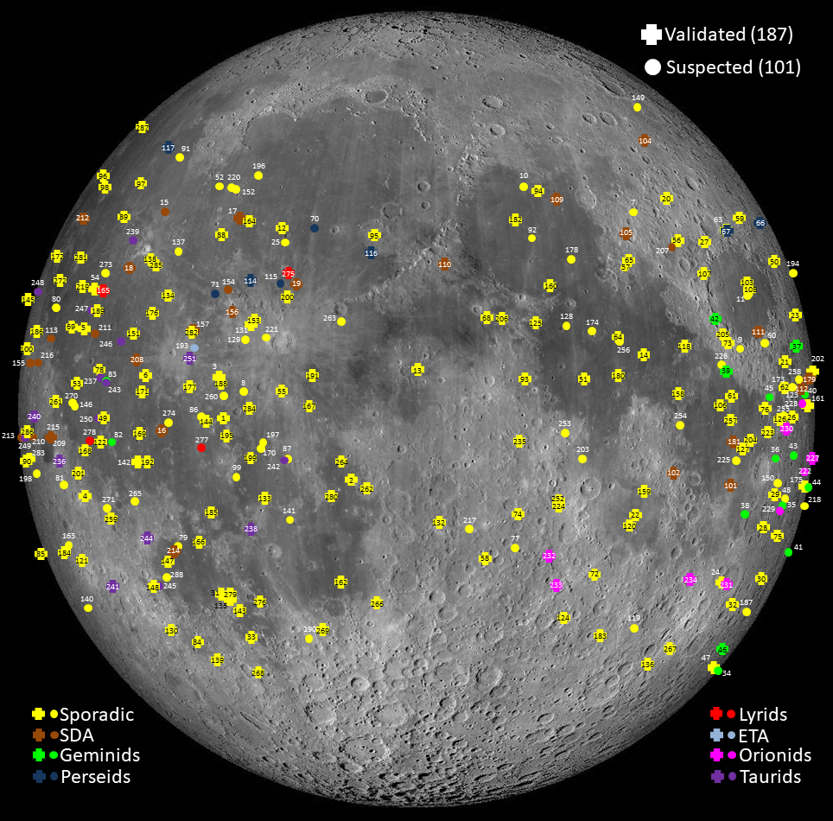
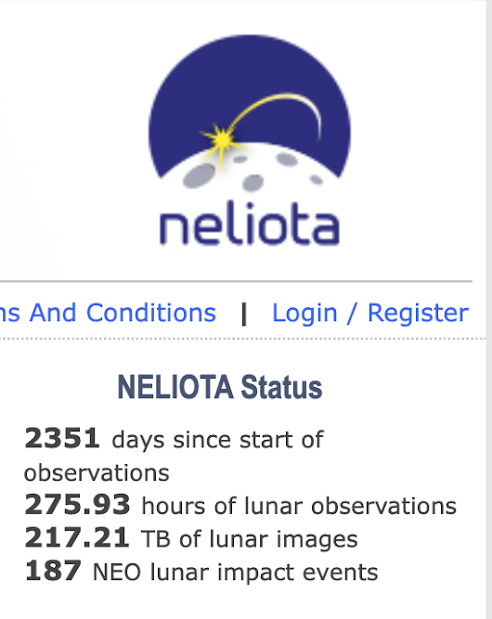
NELIOTA flashes
(2/2017-7/2023)

Slide 8
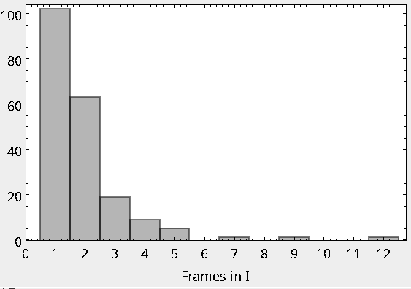
NELIOTA Lunar Impact Flashes database

Slide 9
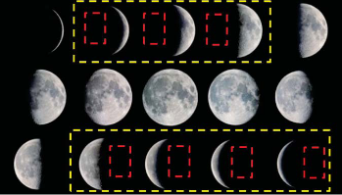
Lunar Impact Flashes
What do we want to do?
Capture lunar impact flashes with >300FPS
Generate light curves of the flashes
NELIOTA Lunar Impact Flash Detection and Event Validation - Liakos et al.

Slide 10
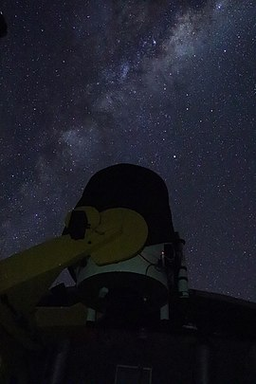
Lunar Impact Flashes
Why do we want to do it?
Observe lunar impact flashes more efficiently by being able to capture flashes dimmer than apparent magnitude 9.
Provide better data for estimating impacting meteroid size and mass.
Create an observation method that is easier to verify impacts
Due to the short integration times required with higher frame rates, we need a big telescope!

Slide 11
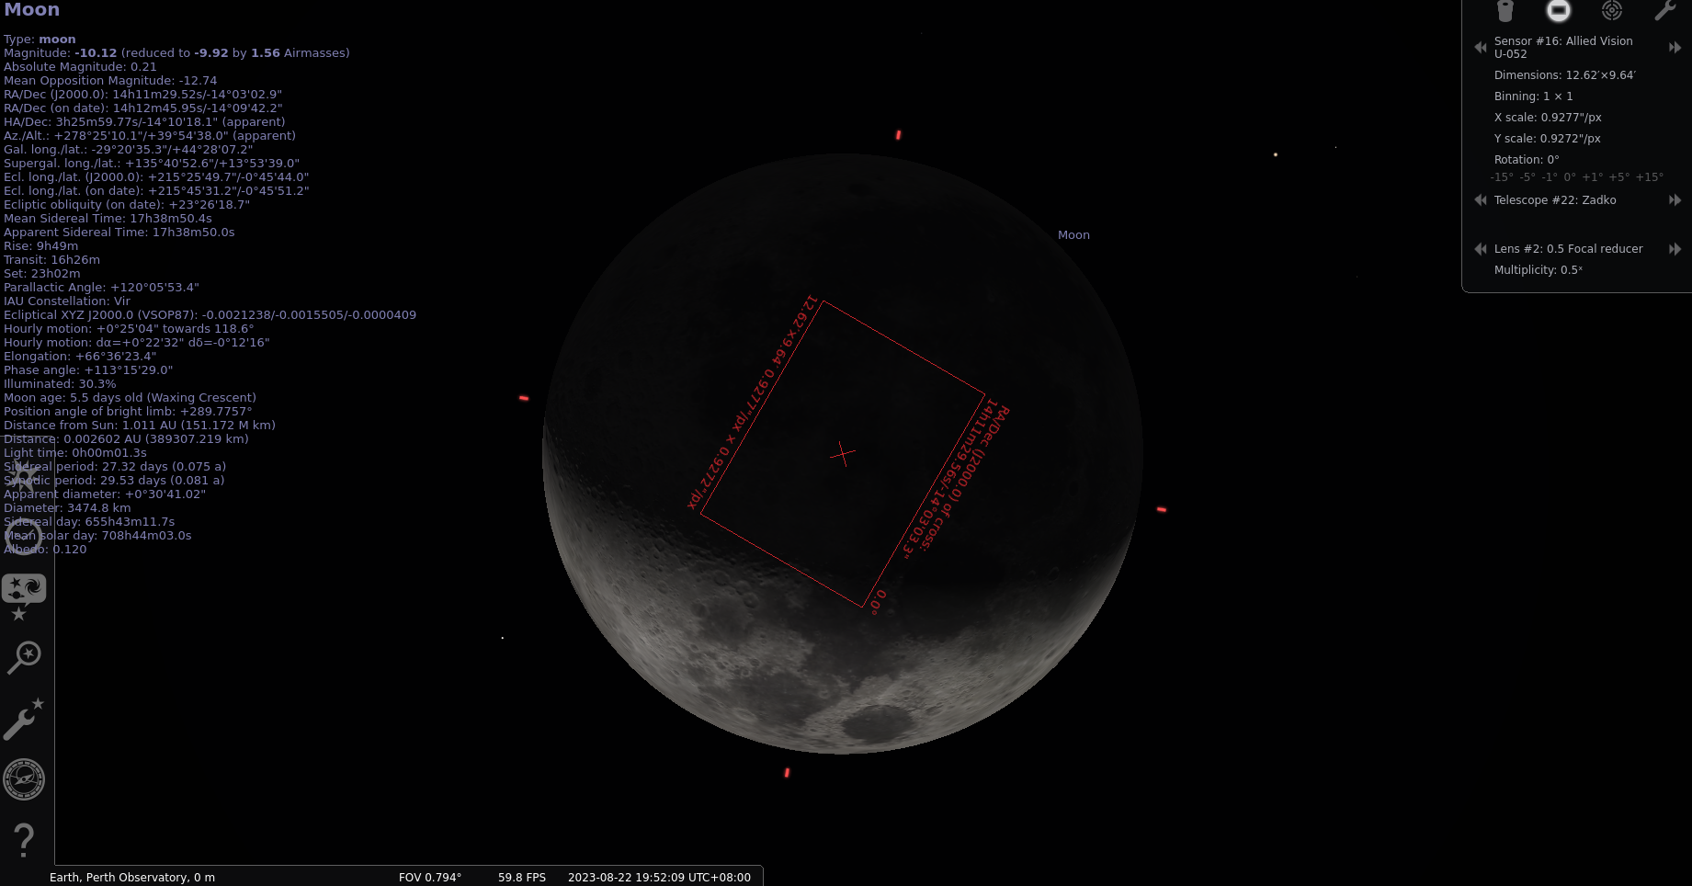
Zadko + Allied Vision U-052 + 0.5 focal reducer

Slide 12
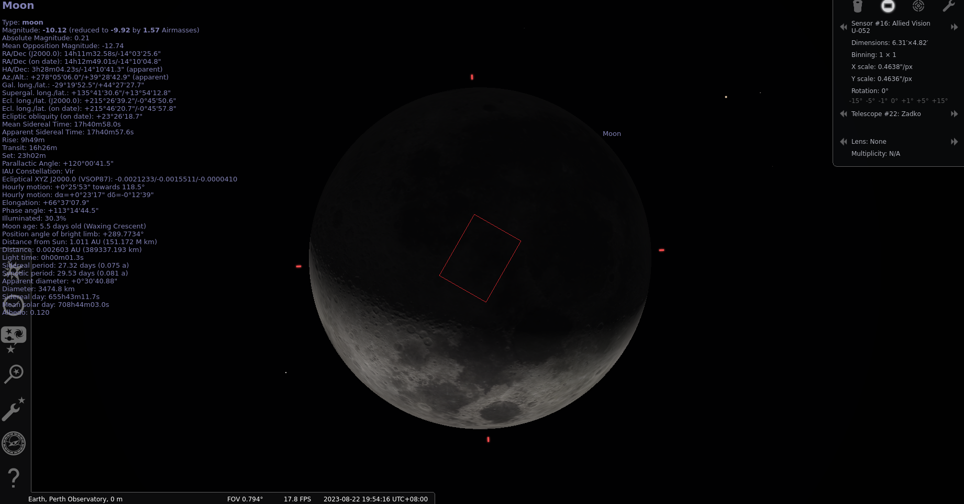
Zadko + Allied Vision U-052

